Slide 1
SMART GROCERY SHOPPING APP WITH BARCODE SCANNING
Submitted by
t sravani(192111308)

Slide 2
INTRODUCTION
A mobile app designed to simplify and modernize the grocery shopping experience.
Uses barcode scanning to instantly identify products using the smartphone camera.
Provides detailed product information, including price, nutrition, and ingredients.
Helps users create, manage, and update shopping lists quickly and accurately.
Aims to save time, reduce errors, and improve shopping convenience.
Supports smarter decision-making with features like price comparison and personalized suggestions.
Enhances budgeting and inventory management for users.

Slide 3
PROBLEM STATEMENT
Traditional grocery shopping is time-consuming and often inefficient.
Managing shopping lists manually can be tedious and error-prone.
Shoppers may forget important items or buy duplicates due to poor list management.
Comparing prices across different stores is difficult and time-consuming.
Access to detailed product information (like nutrition, ingredients, or allergens) is limited in-store.
Budget tracking during shopping is often overlooked or hard to manage manually.
There's a lack of real-time, smart assistance to support informed decision-making while shopping.
A digital solution is needed to improve convenience, accuracy, and overall shopping efficiency.

Slide 4
PROJECT OBJECTIVE
The Primary objective of this project is to design and implement an smart grocery shopping app with barcode scanning. The specific objectives includes:
1.Implement Barcode Scanning Functionality: Enable users to scan product barcodes using their smartphone camera for instant identification and data retrieval.
2.Facilitate Smart Shopping List Creation: Allow users to add items to their shopping list through barcode scans or manual entry, and organize them efficiently.
3.Support Price Comparison Across Stores: Help users find the best deals by comparing prices of scanned products from multiple retailers (if integrated).

Slide 5
4.Enable Budget Tracking: Track total spending based on scanned or added items to help users stay within their grocery budget.
5. Maintain Purchase History and Receipts: Store previous purchases and scanned items for easy reference, reordering, and record keeping.
6. Offer Personalized Recommendations: Use shopping history and preferences to suggest relevant products or alternatives.
7. Assist in Inventory Management: Allow users to keep track of items they already have at home to prevent overbuying.
8. Enhance Shopping Efficiency: Reduce time spent shopping by streamlining the process from list creation to checkout.
9. Promote Sustainable Shopping Habits: Help users manage expiry dates and reduce food waste with alerts and smart usage suggestions.

Slide 6
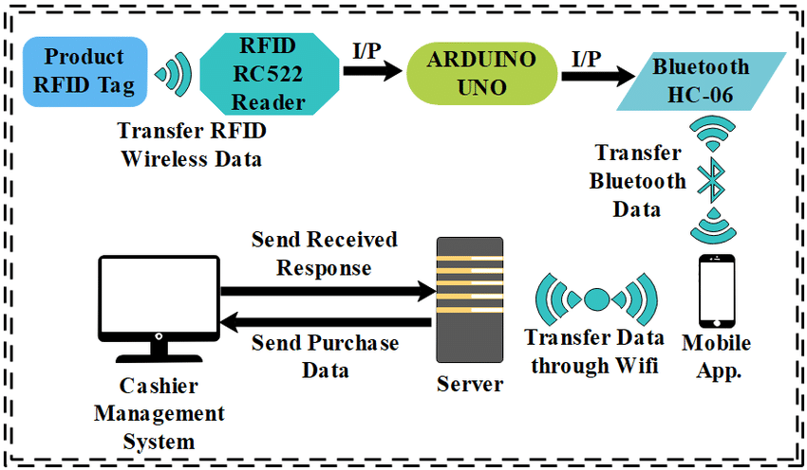
ARCHITECTURE
Architecture design of smart grocery shopping app based on RFID technology.

Slide 7
METHODOLOGY
Requirement Analysis: Gather and analyze user needs, market trends, and technical requirements. Define core features such as barcode scanning, product info retrieval, shopping list creation, and budget tracking.
System Design & Architecture: Design the app’s architecture, user interface (UI), and user experience (UX). Plan how modules like barcode scanning, database access, and user profiles will interact seamlessly.
Database Development: Build a robust backend database to store product information, user data, shopping history, and price details. Integrate external APIs for real-time product and pricing data, if needed.
Barcode Scanning Integration: Implement barcode scanning functionality using the device camera with libraries like ZXing or ML Kit. Ensure the system decodes various barcode types accurately and quickly.

Slide 8
Feature Implementation: Develop core app features such as smart shopping list creation, price comparison, budget tracker, and product detail views. Ensure smooth navigation and responsiveness
Testing and Debugging: Perform rigorous testing, including unit, integration, and user acceptance testing. Identify and fix bugs, optimize performance, and ensure usability across different devices.
Deployment: Launch the app on platforms like Google Play Store and Apple App Store. Ensure proper documentation, and setup for updates and maintenance.
User Feedback and Improvement: Collect user feedback post-launch to understand usability, issues, and suggestions. Use this input to release updates and continuously improve the app’s functionality.

Slide 9
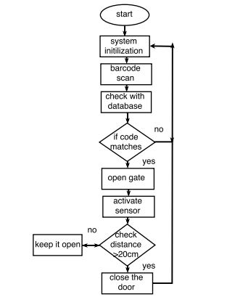
FLOWCHART

Slide 10
WORKFLOW
Workflow of the Smart Grocery Shopping App with Barcode Scanning:
1.Start: The process begins with the customer deciding to go grocery shopping.
2.Prepare Shopping List: The customer might consult a pre-existing shopping list
or decide on items they need to buy at the store.
3. Navigate Store: The customer moves through the grocery store, browsing aisles
and selecting items.
4. Navigate Store: The customer moves through the grocery store, browsing aisles
and selecting items.
5. Navigate Store: The customer moves through the grocery store, browsing aisles
and selecting items.

Slide 11
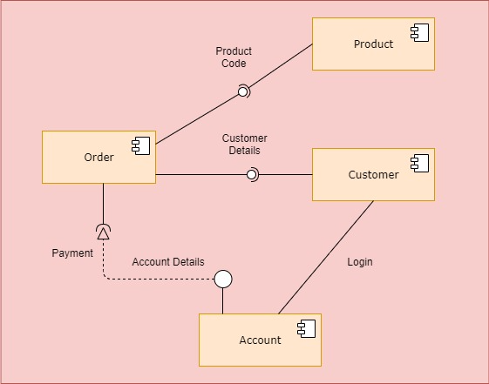
6.Repeat Steps 4 & 5: The customer repeats scanning and adding items
to their cart until all desired purchases are scanned.
7.Checkout: The customer proceeds to the checkout counter or uses a
self-checkout option.
8.Payment: The customer makes payment for the items using a chosen method (cash, card, etc.).
9.Receive Receipt: The customer receives a receipt as proof of purchase.
10.End: The grocery shopping process concludes.

Slide 12
FUTURE SCOPE
AI-Powered Recommendations: Future versions can use advanced AI and machine learning to suggest healthier, eco-friendly, or cost-effective alternatives based on user behavior and preferences.
Integration with Online Retailers: The app can be integrated with major e-commerce platforms, enabling direct ordering and home delivery of groceries, making the shopping process fully digital.
Smart Pantry Management: Future upgrades could include automatic inventory tracking using smart kitchen devices to update home stock in real time and notify about low or expiring items.
In-App Payments & Loyalty Rewards: Secure in-app payment systems and loyalty point tracking could be added, offering a seamless checkout experience and customer retention incentives.
Data Analytics Dashboard for Users: Providing visual insights into users’ spending habits, dietary patterns, and purchase trends can help them make more informed and conscious choices.

Slide 13
CONCLUSION
The Smart Grocery Shopping App with Barcode Scanning offers a modern, efficient, and user-friendly solution to common challenges faced during grocery shopping.
By integrating barcode scanning technology, the app simplifies product identification, enhances list management, and provides detailed product information instantly.
With features like price comparison, budget tracking, and personalized suggestions, it not only saves time but also supports smarter and more informed purchasing decisions.
As the app evolves, it holds great potential to further transform the grocery shopping experience through AI, smart home integration, and global accessibility.

Slide 14
THANK YOU

